Slide 1
Lake Travis FFA Alumni
October 4, 2022

Slide 2
Agenda
Welcome – Thank yous!
Minutes/Secretary Update
Treasurer’s Report/Budget Review
Sponsorships/Fundraiser Update
Cav Classic/TCYS Needs
Teacher Update
What the Kids are Talking About
Celebrating Successes
New Business/Questions
Mark Your Calendar

Slide 3
September Meeting Minutes
Susan Dow
Review minutes from September meeting (sent in email)
Where to find Minutes of each meeting
Motion to Approve

Slide 4
Secretary Update
Susan Dow
Reminder: Everyone please sign in, if you haven’t already done so.
Membership dues and forms for BOTH students and parents due by Friday 10/14/22 to be in good standing.
38 members to date

Slide 5
Treasurer’s Report
September Net Cash Flow
Up $3,919.50
Expenses: $3,728.50
Operating Expenses: $33.98
Chapter Support: $1,983.29
Senior Scholarships: $1,000
Cav Classic: $711.23
Income: $7,648
Membership Dues: $1,250
Sponsorships: $6,200
Decals/Signs: $198
Motion to Approve?

Slide 6
2022-2023 Budget Overview
Jenn De Leon
Overview
Built a budget based on 2021-2022 spend and available historical data
sustainable numbers in most categories
assigned income streams to expense categories
if approved, will use new categories in banking software for improved tracking and potential long term trend analysis

Slide 7
Budget - Deeper Dive
Jenn De Leon
Expense Category (9) | Funding Source (5) | Budget: $38K | 21-22 Expenses: ~$27K | 21-22 Income: ~$33K
Sponsorships TCYS | Sponsorships | $19,500* | $11,779.65 | $14,380 (cash)
Senior Scholarships Chapter Support | Pet Shot Clinic | $6,500* | $3,250.00 $500.00 | $8,250
Operating Expenses Spirit Wear | Membership Dues | $2,800 | $1,008.13 $1,559.30 | $1,700
Cav Classic | Cav Classic | $8,000 | $7,629.31 | $5,139
Cantina Other Expenses | General Fundraising | $1,200 | $760.13 $0 | $3,806.10

Slide 8
2022-2023 Budget
Jenn De Leon
Comments?
Motion to approve?

Slide 9
2022 - 2023 LT FFA Sponsors
Thank you!!
Diamond
H&H Ranch Lakeway
Wild Hare Construction
Gold
Spicewood Vet Clinic
The Foxx Family
Shipp Family Dentistry
Holly Noak

Slide 10
2022 - 2023 LT FFA Sponsors
Thank you!!
Holly Noak
Silver
A+ Federal Credit Union
Nitro Swimming
The Wise Family
McCoys Building & Supply (Bee Cave)
Zilker Media
Rudy’s “Country Store” & Bar-B-Q
Reata Insurance Group
The Vance Family
Bronze
VIK Complete Care
Lakeway Vision Associates
Flipnastics
Evans Livestock
Ben Archer - State Farm
China Steakhouse
The Allmand Family
Shout outs to BYC Construction, 512 Frenchies & Malco Electric for being Cav Classic buckle sponsors!!

Slide 11
Fundraising
Holly Noak
Sponsorship Drive
Deadline for logos to get on shirts: October 12th
$25,000 Goal Update (as of 10/1/22)
Collected: $14,200
Personal Family Contributions
Can be given to Jenn DeLeon or Holly Noak
Preferred by 10/12
$500 donated/raised by each family
Drawing for those who have contributed already

Slide 12
Fundraising
Holly Noak
Raising Cane’s Spirit Night
Friday, October 7, all day (No School / HoCo Game day)
Pet Shot Clinic – Aline Crompton
Monday, October 24, 5 p.m.
All students volunteer; adults who signed up
Be here 4:30 p.m.
P Terry’s Spirit Night
Monday, October 24, 3 p.m – close
Go after Pet Shot Clinic!

Slide 13
Cav Classic Updates
Kathleen Fisher
Signup will go out after meeting – ALL parents and students volunteer (even if not showing)
Set-up Thursday 11/10/22 2:30 -6:30 p.m. DSRP – bring gloves, mallets
Show Saturday 11/12/22 – all day (more info at next meeting about loading/prepping animals)
See FB page for more info

Slide 14
TCYS Updates
Kathleen Fisher
Entries due (both Youth Fair AND livestock projects) October 12, 2022
Show is January 12-14, 2023 at Travis County Expo Center – plan to be there all days if showing animals
Housing needs – rent RVs?
Cantina needs – needs a chair
Pen Decorating – Wednesday evening
Pen Set-up/Tear Down

Slide 15
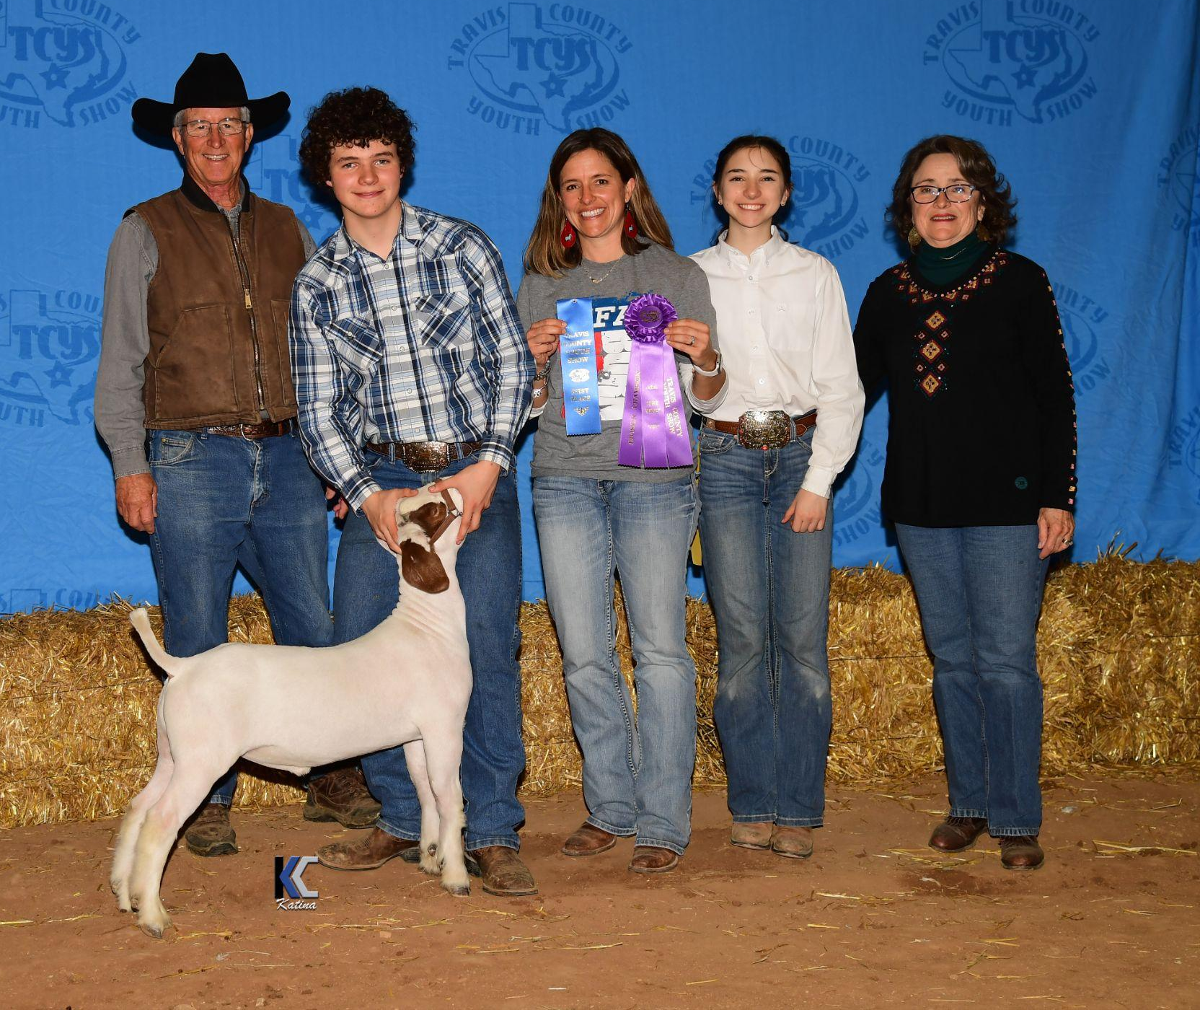
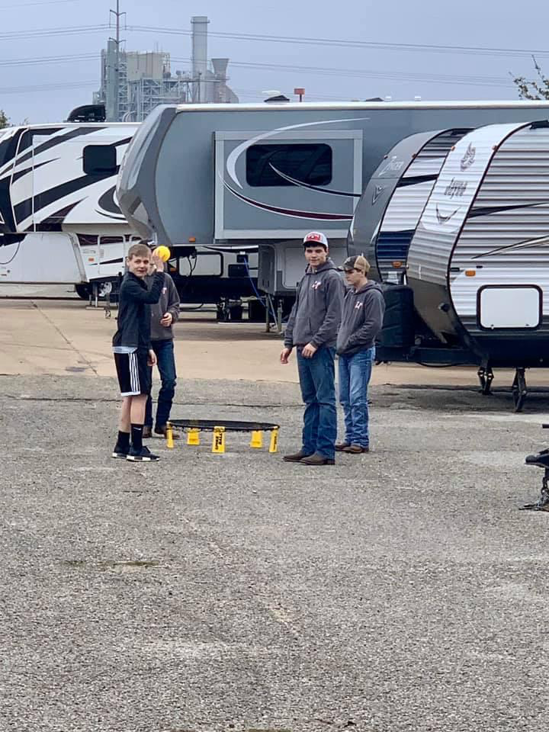
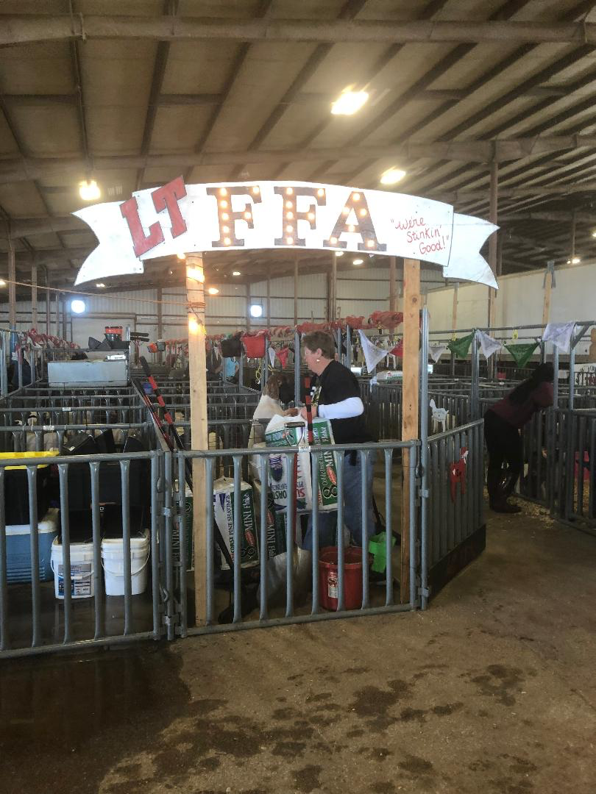
TCYS Show-N-Tell

Slide 16
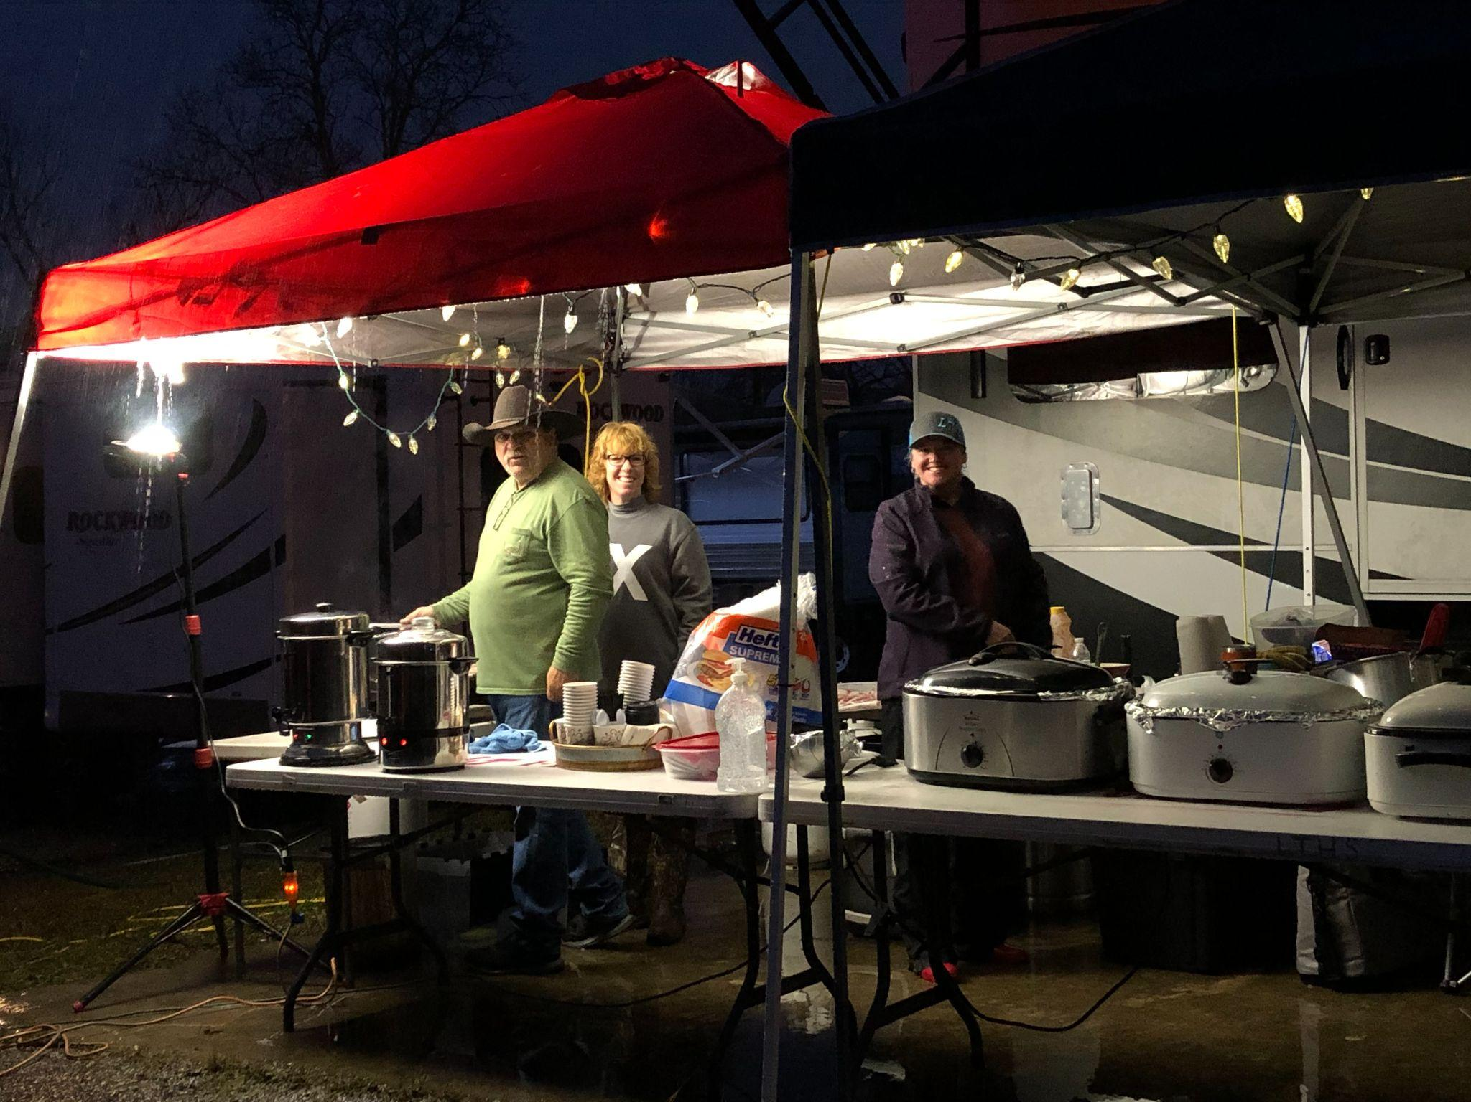
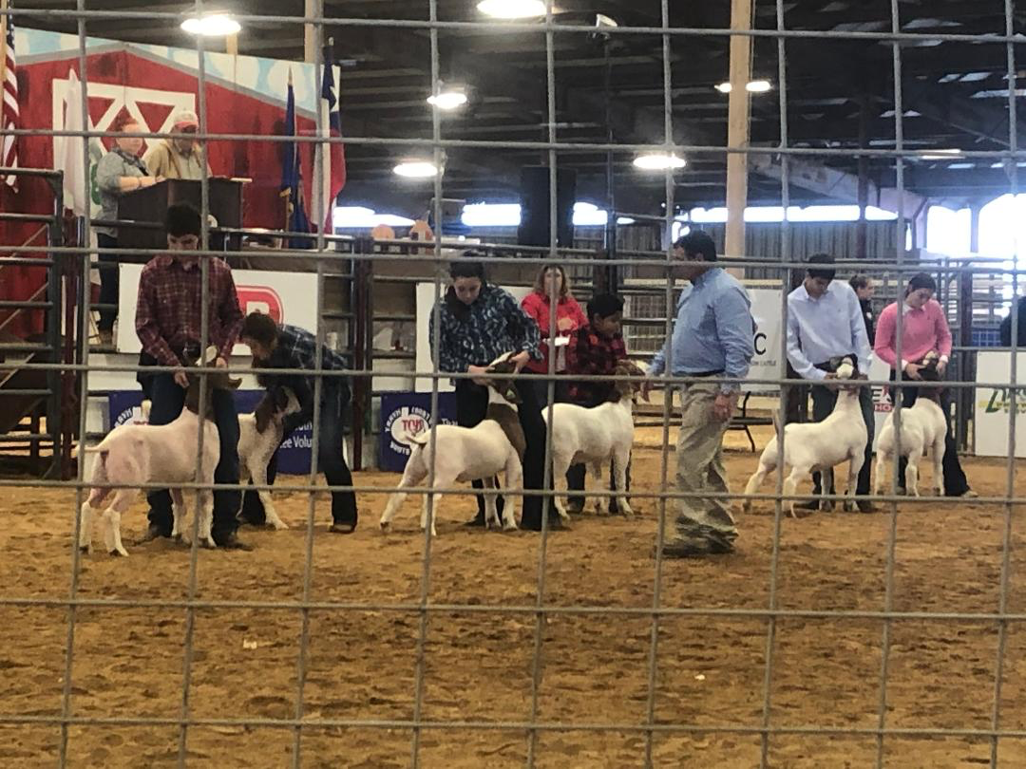
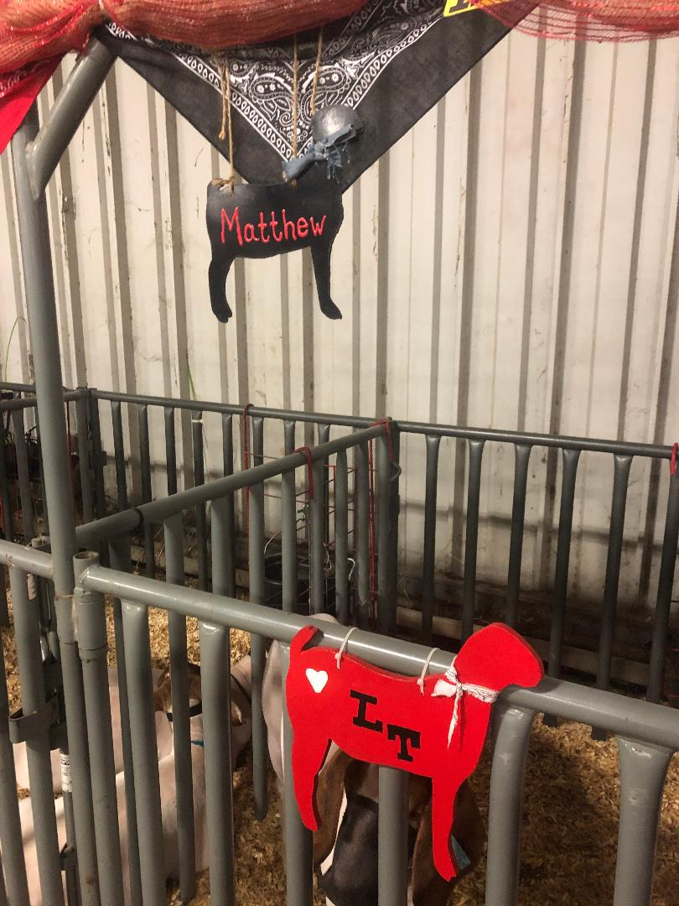
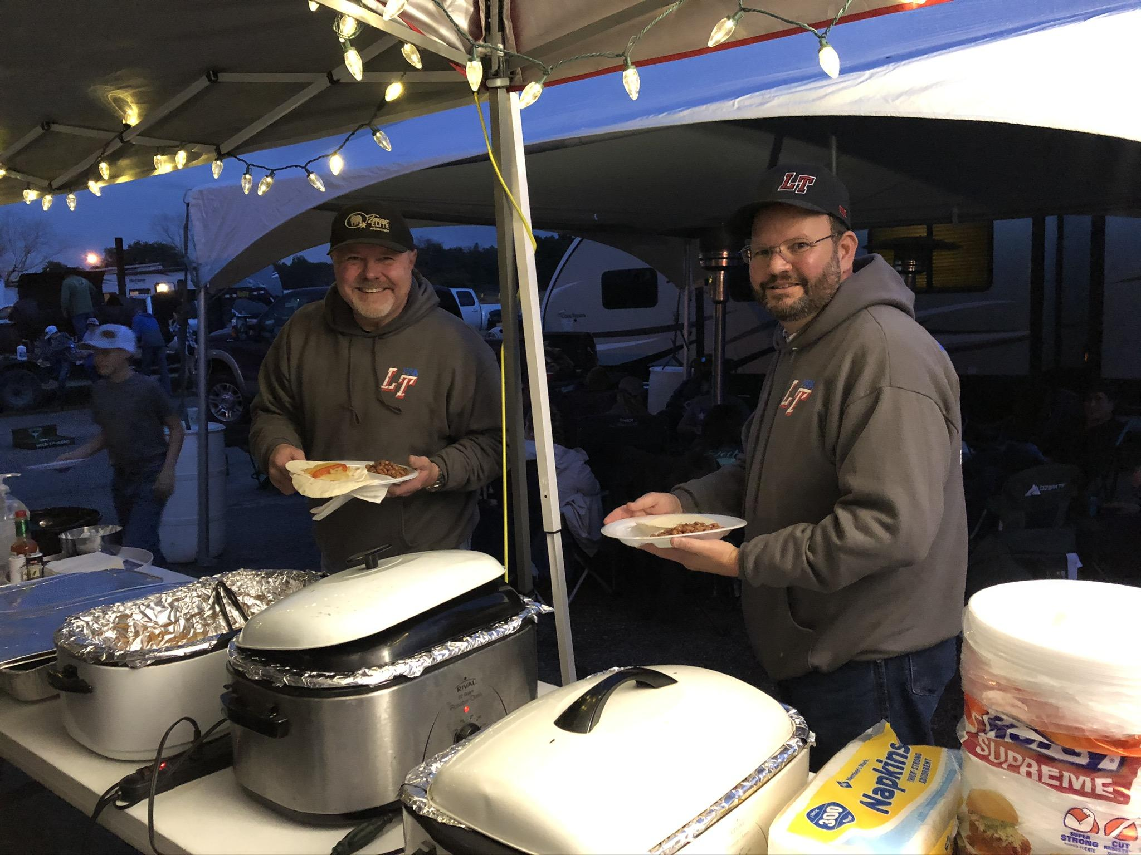
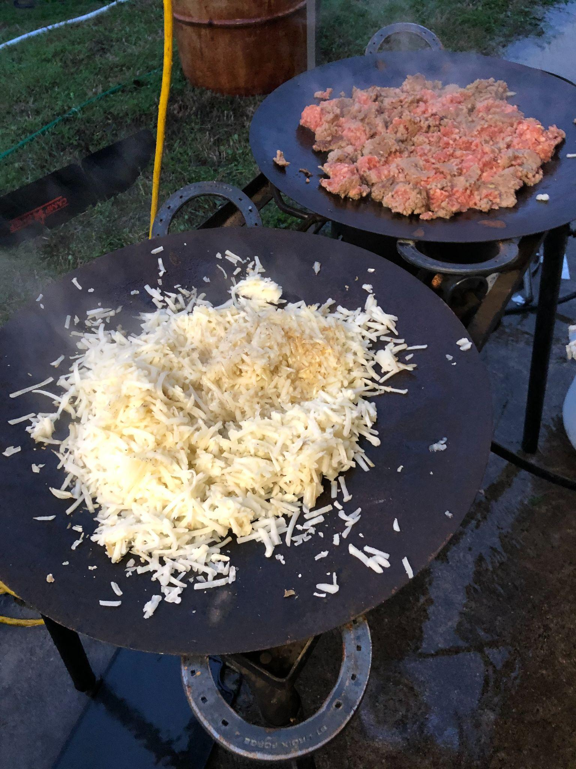
TCYS Show-N-Tell Continued

Slide 17
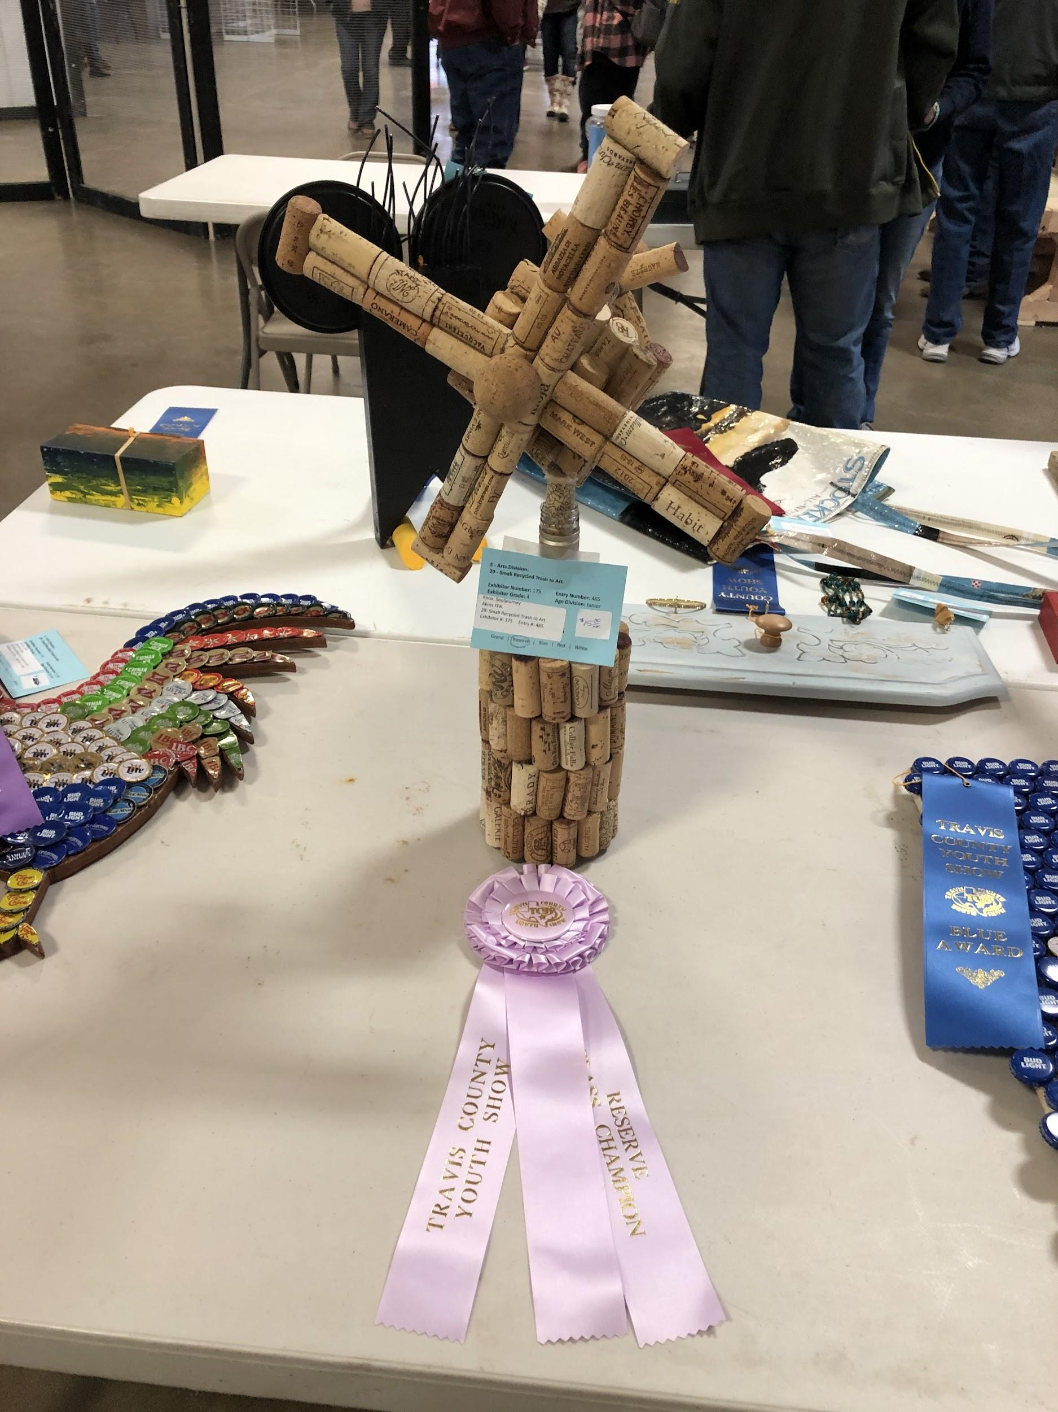
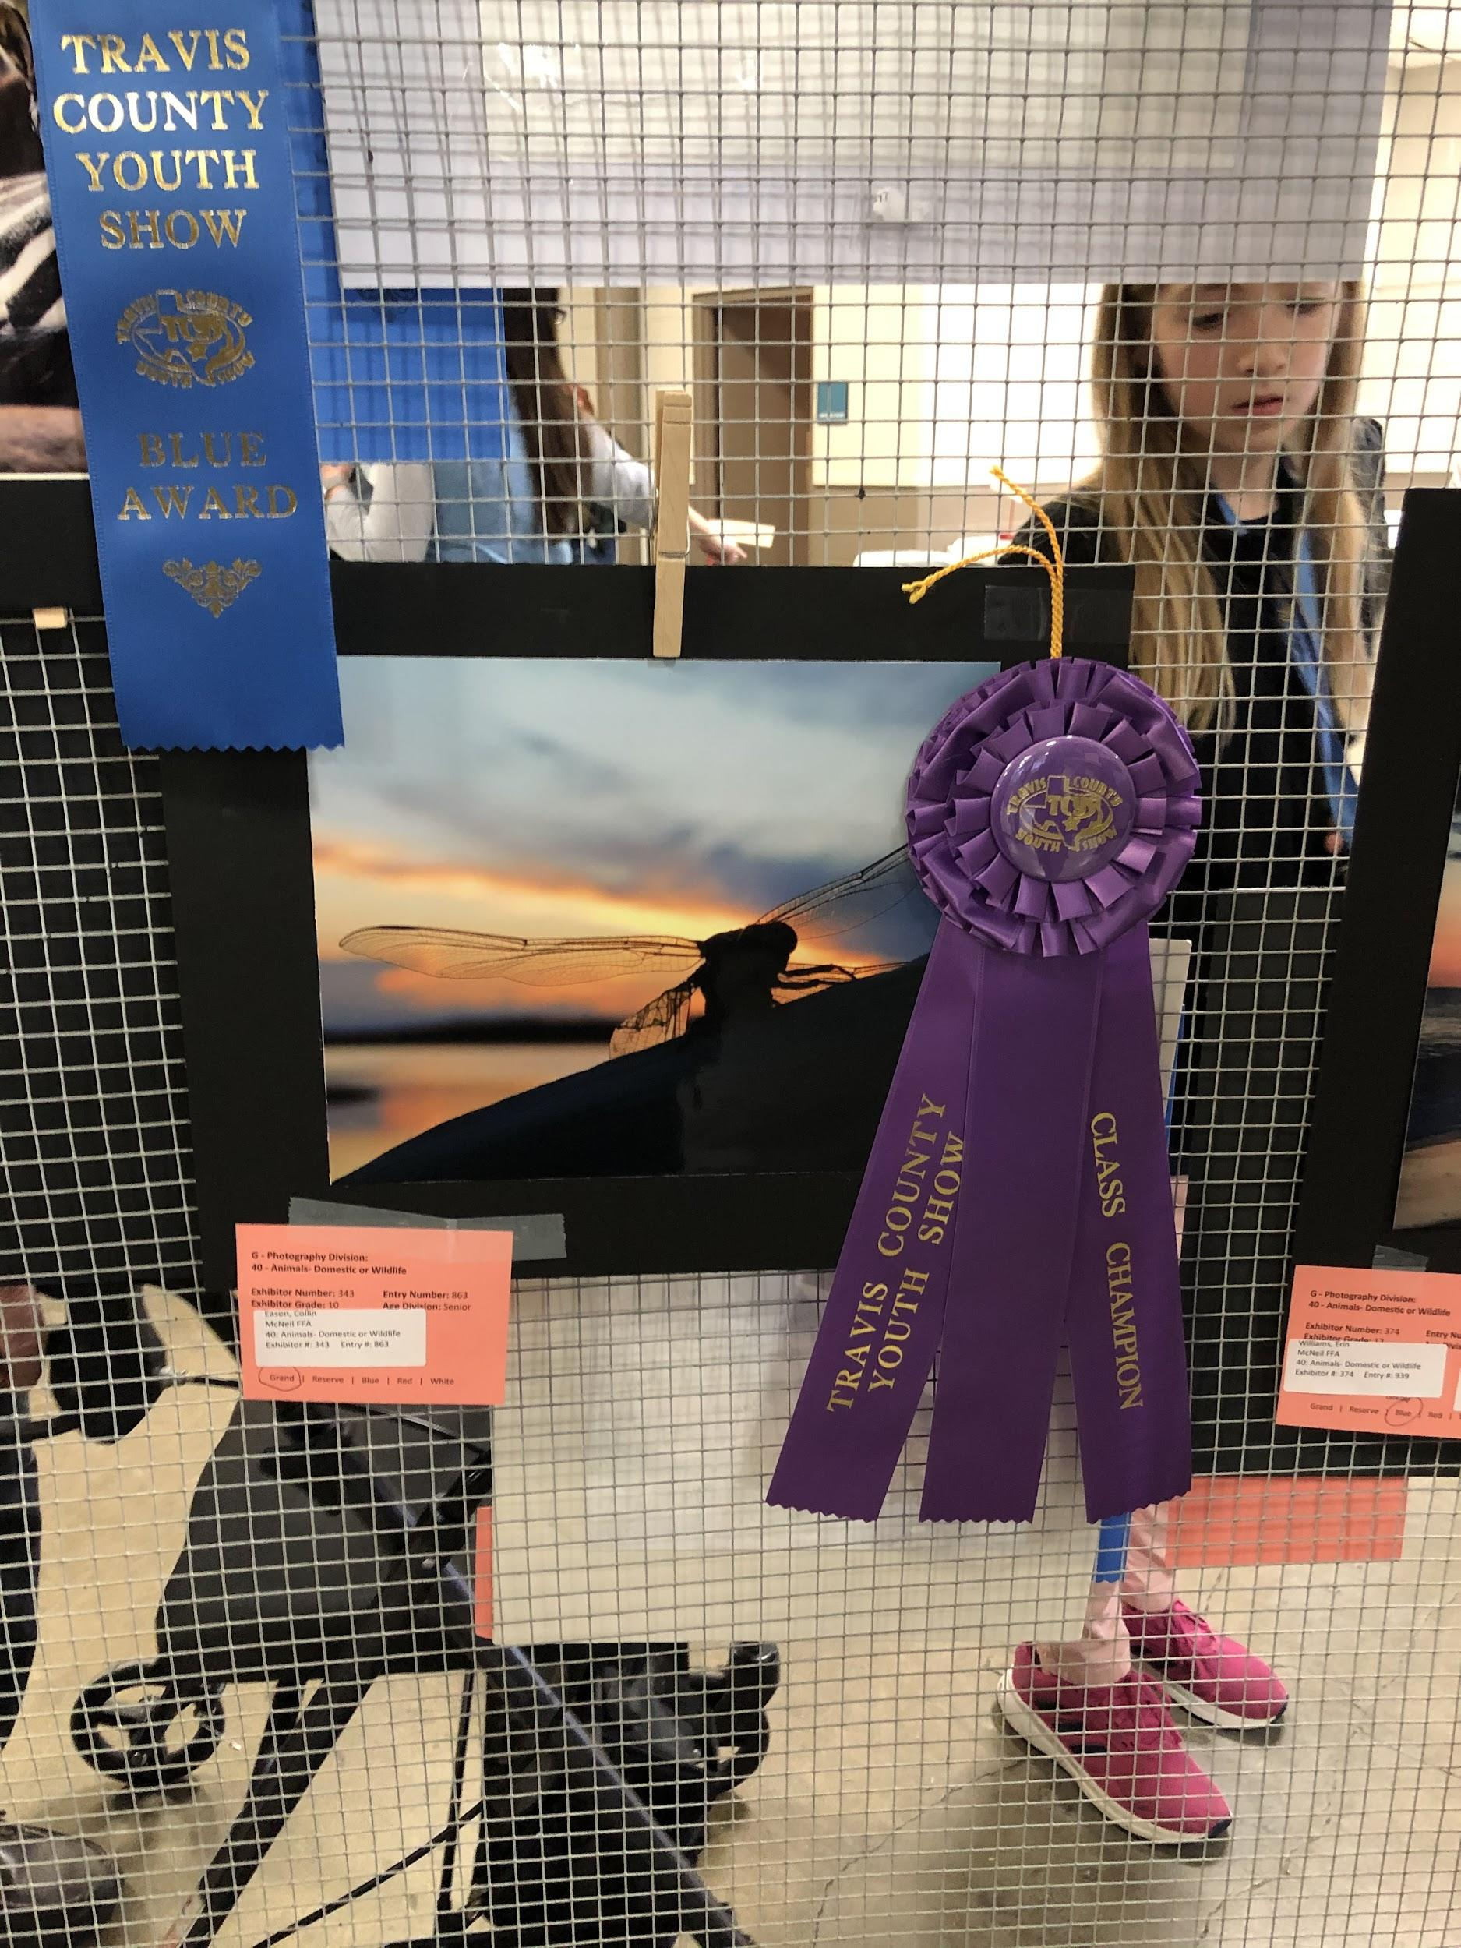
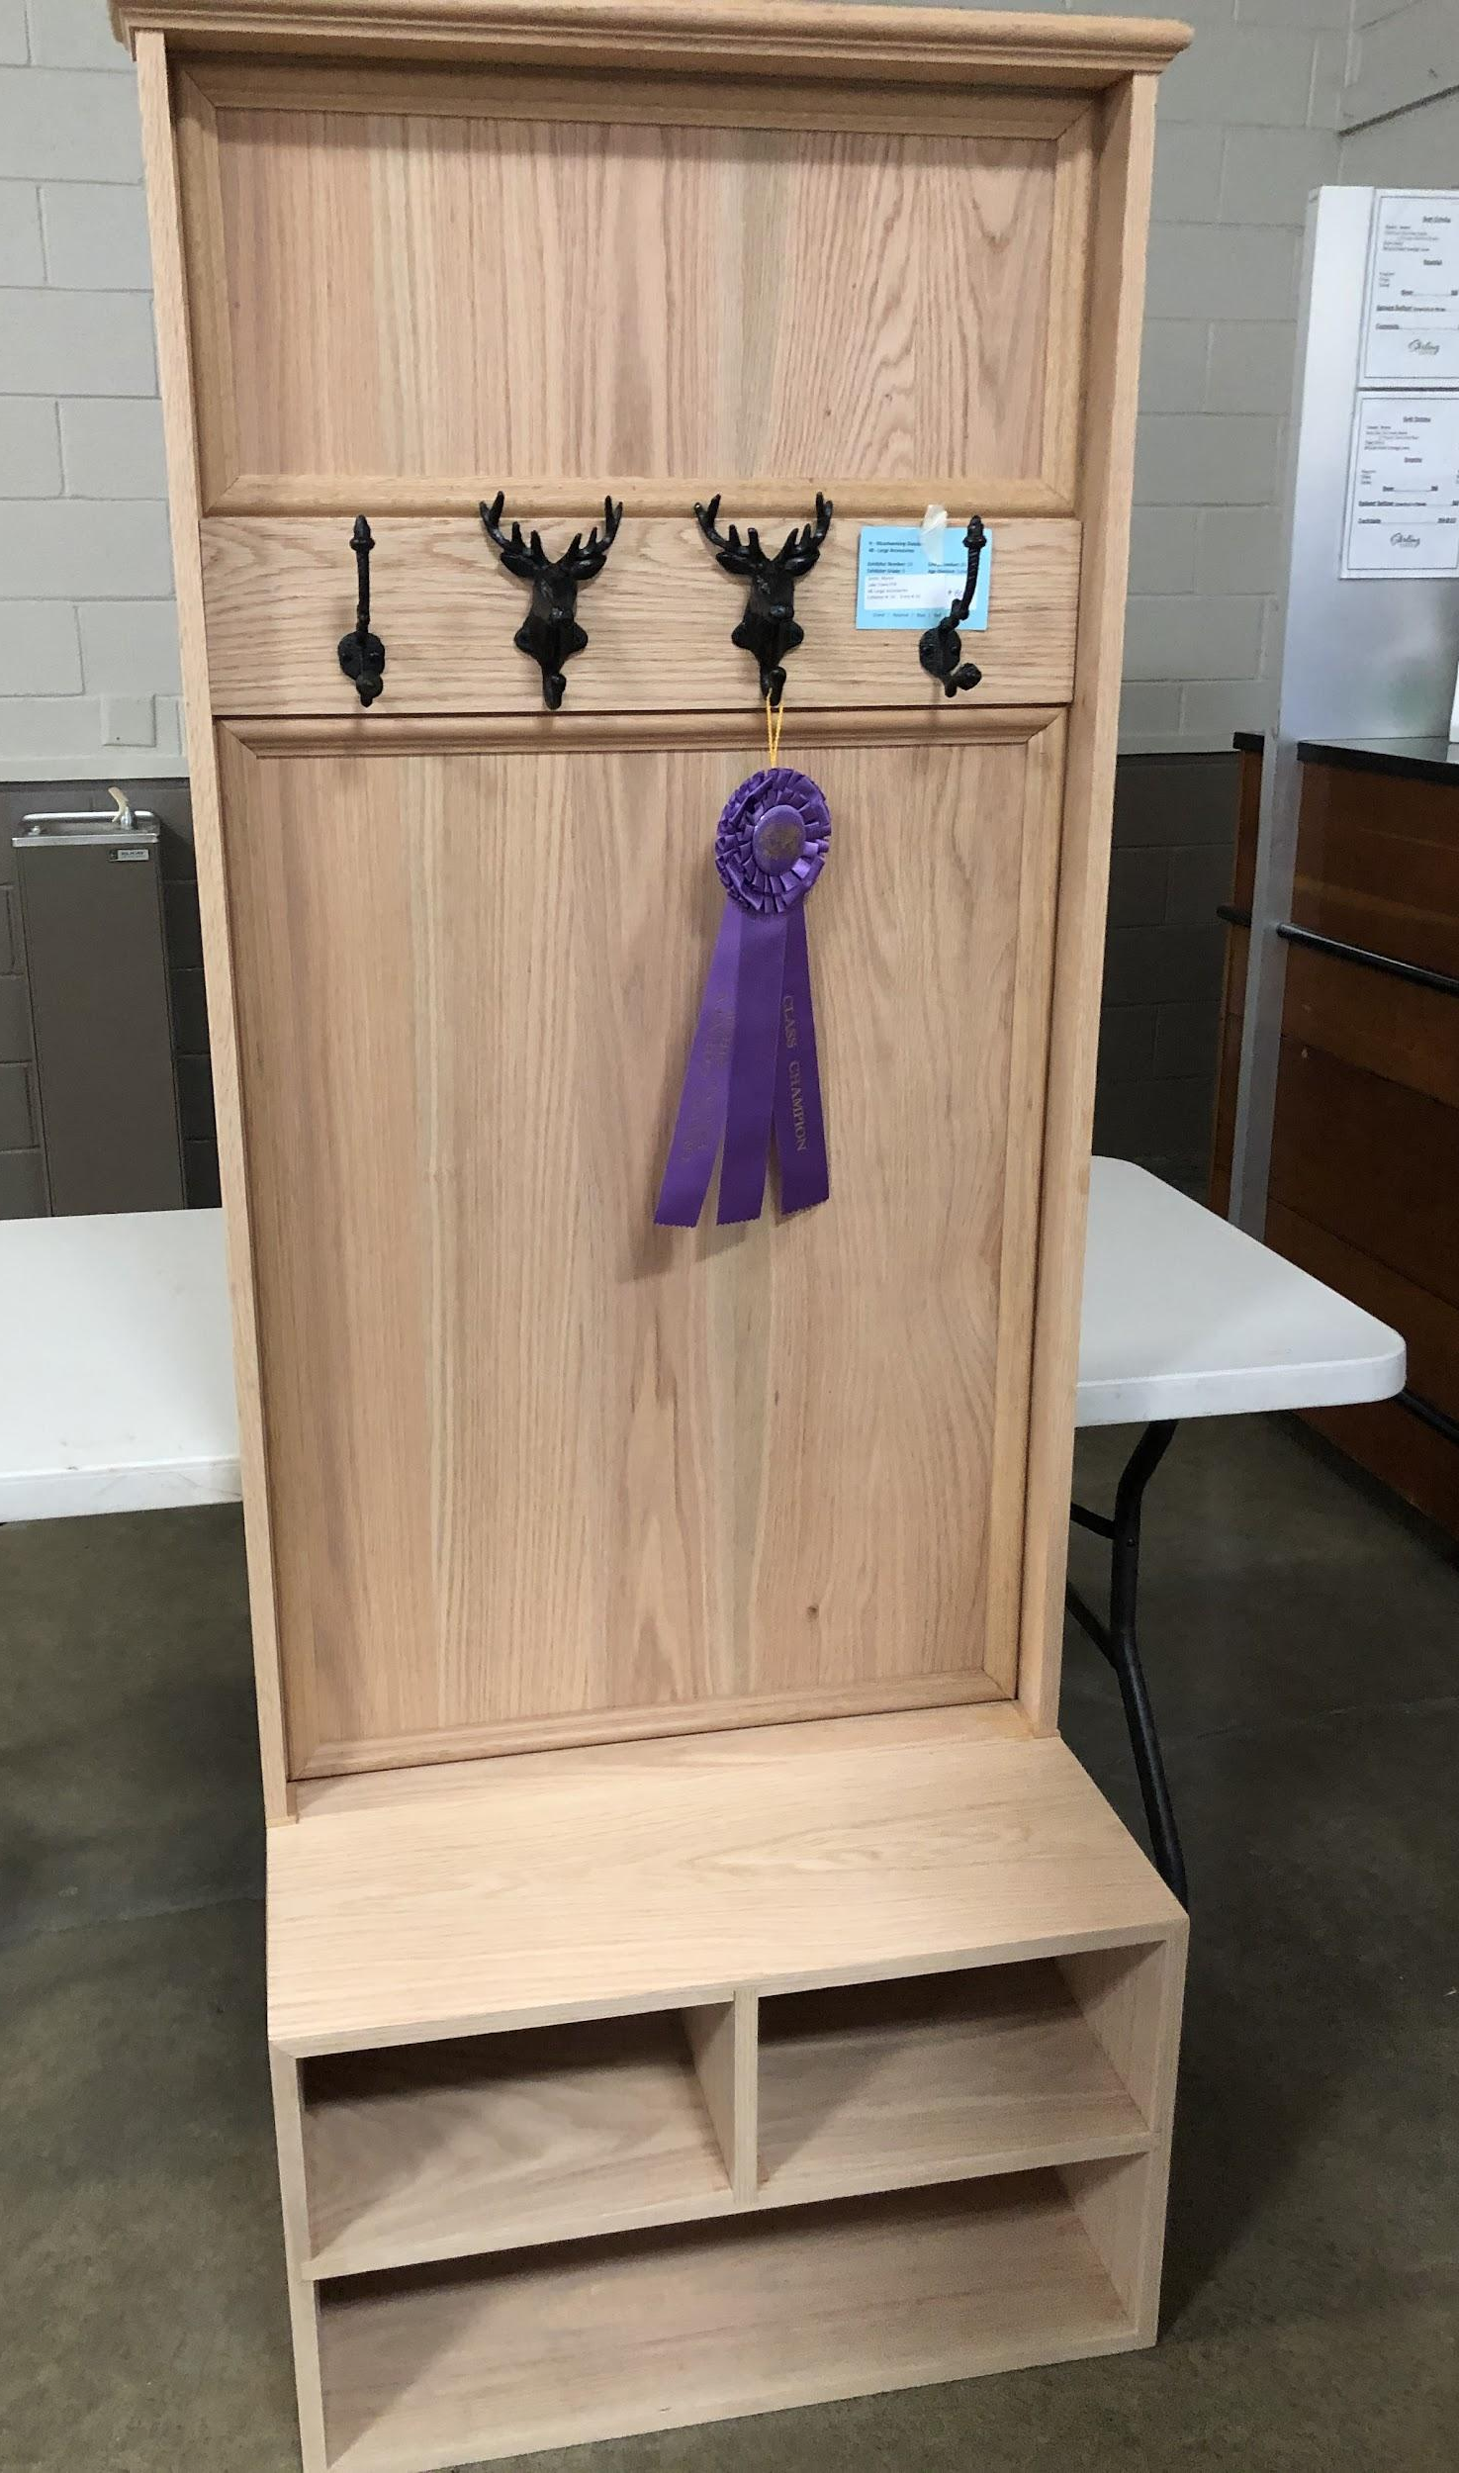
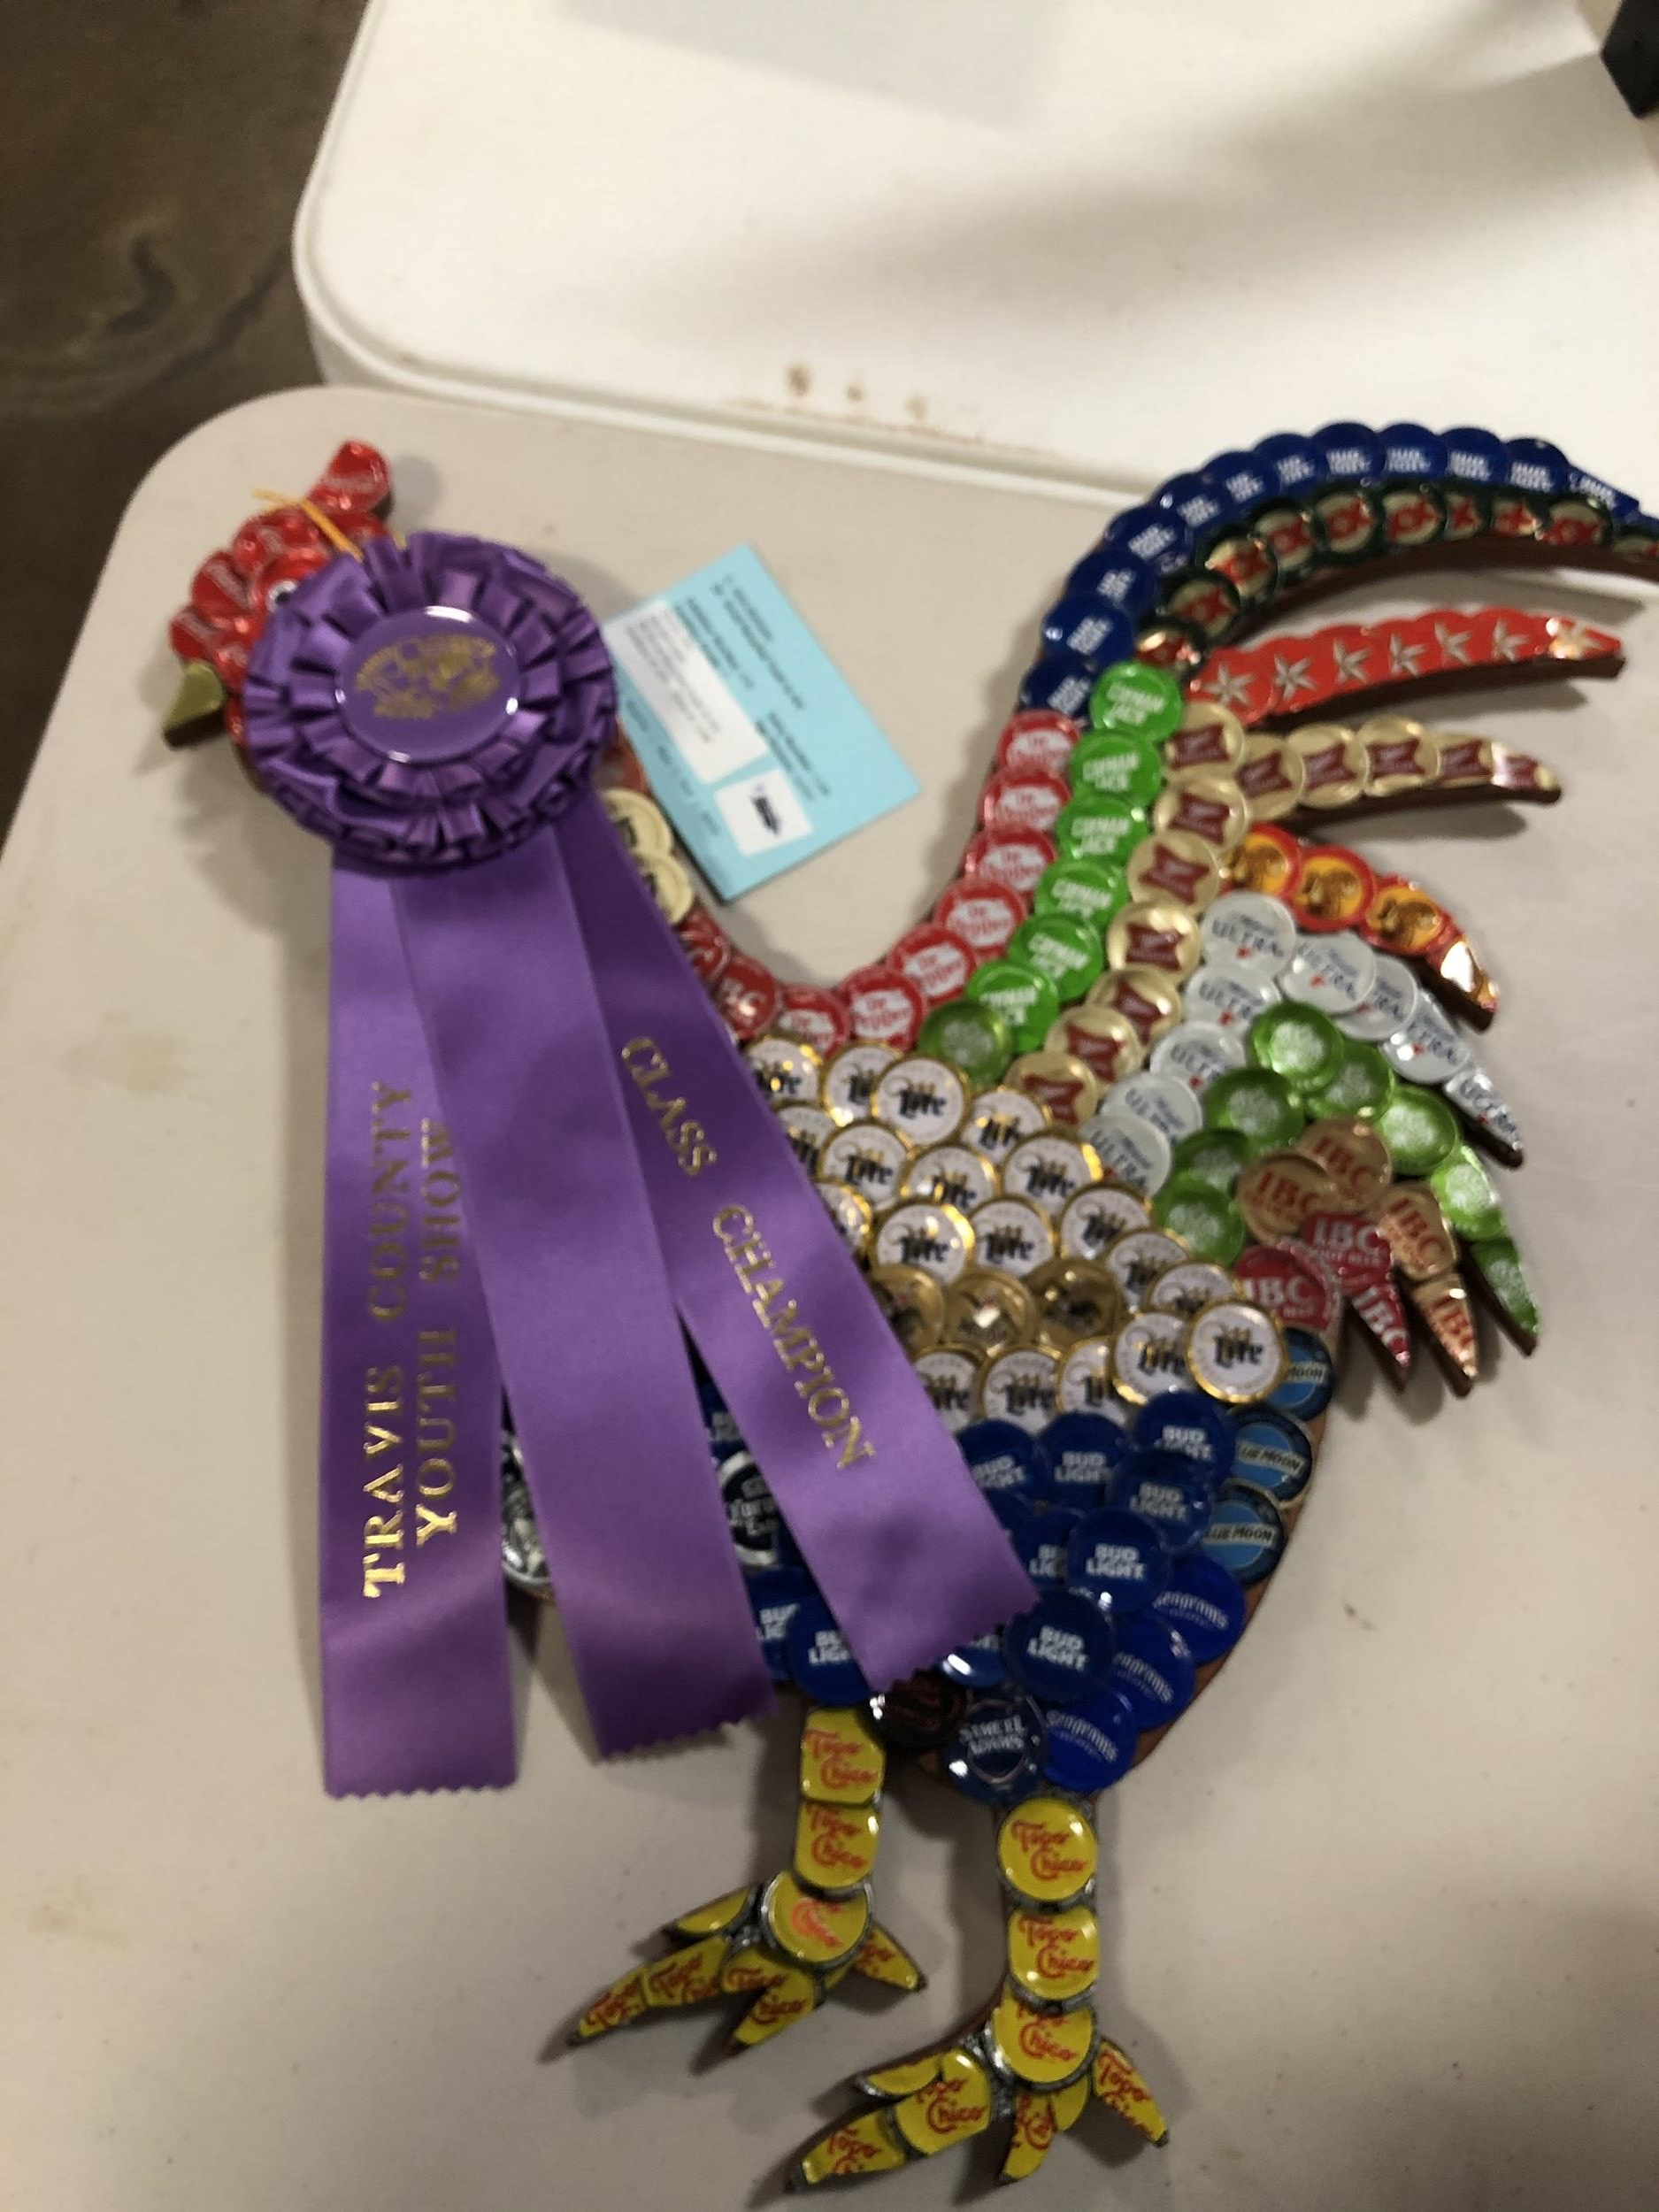
TCYS Youth Fair

Slide 18
Teacher Update
P. White
What’s happened since last meeting: Goat/lamb/Pig arrival, LDE teams forming, Capital District Meeting
Pen Rent/Deposits due asap for Good Standing (includes basic meds for anything we can treat)
See Mr K White and make sure Pen Deposits and Rent have been paid……to be in good standing!

Slide 19
Teacher Update
P. White
In the barns: twice a day - Feed/Clean Pens/Sweep, not just in front of their pen, help out with keeping the whole barn tidy and clean.
Trash/Poop goes to the dumpster-no buckets of poop left in barn!
What to do if animal seems sick (how do I know if it is sick?)
How to prepare for cold weather (buy heat lamps now) nights in low 40’s
Quality Counts -- what it is and when it has to be done Nov 12
No pass, no play rules -- timing for passing grades necessary to show Most important date is Dec 16
Scheduling slaughter dates for pigs - now for January
Barn contract states - animals are to be out of barn no later than 2 weeks after their last show. For a lot that is TCYS, unless attending a major show.

Slide 20
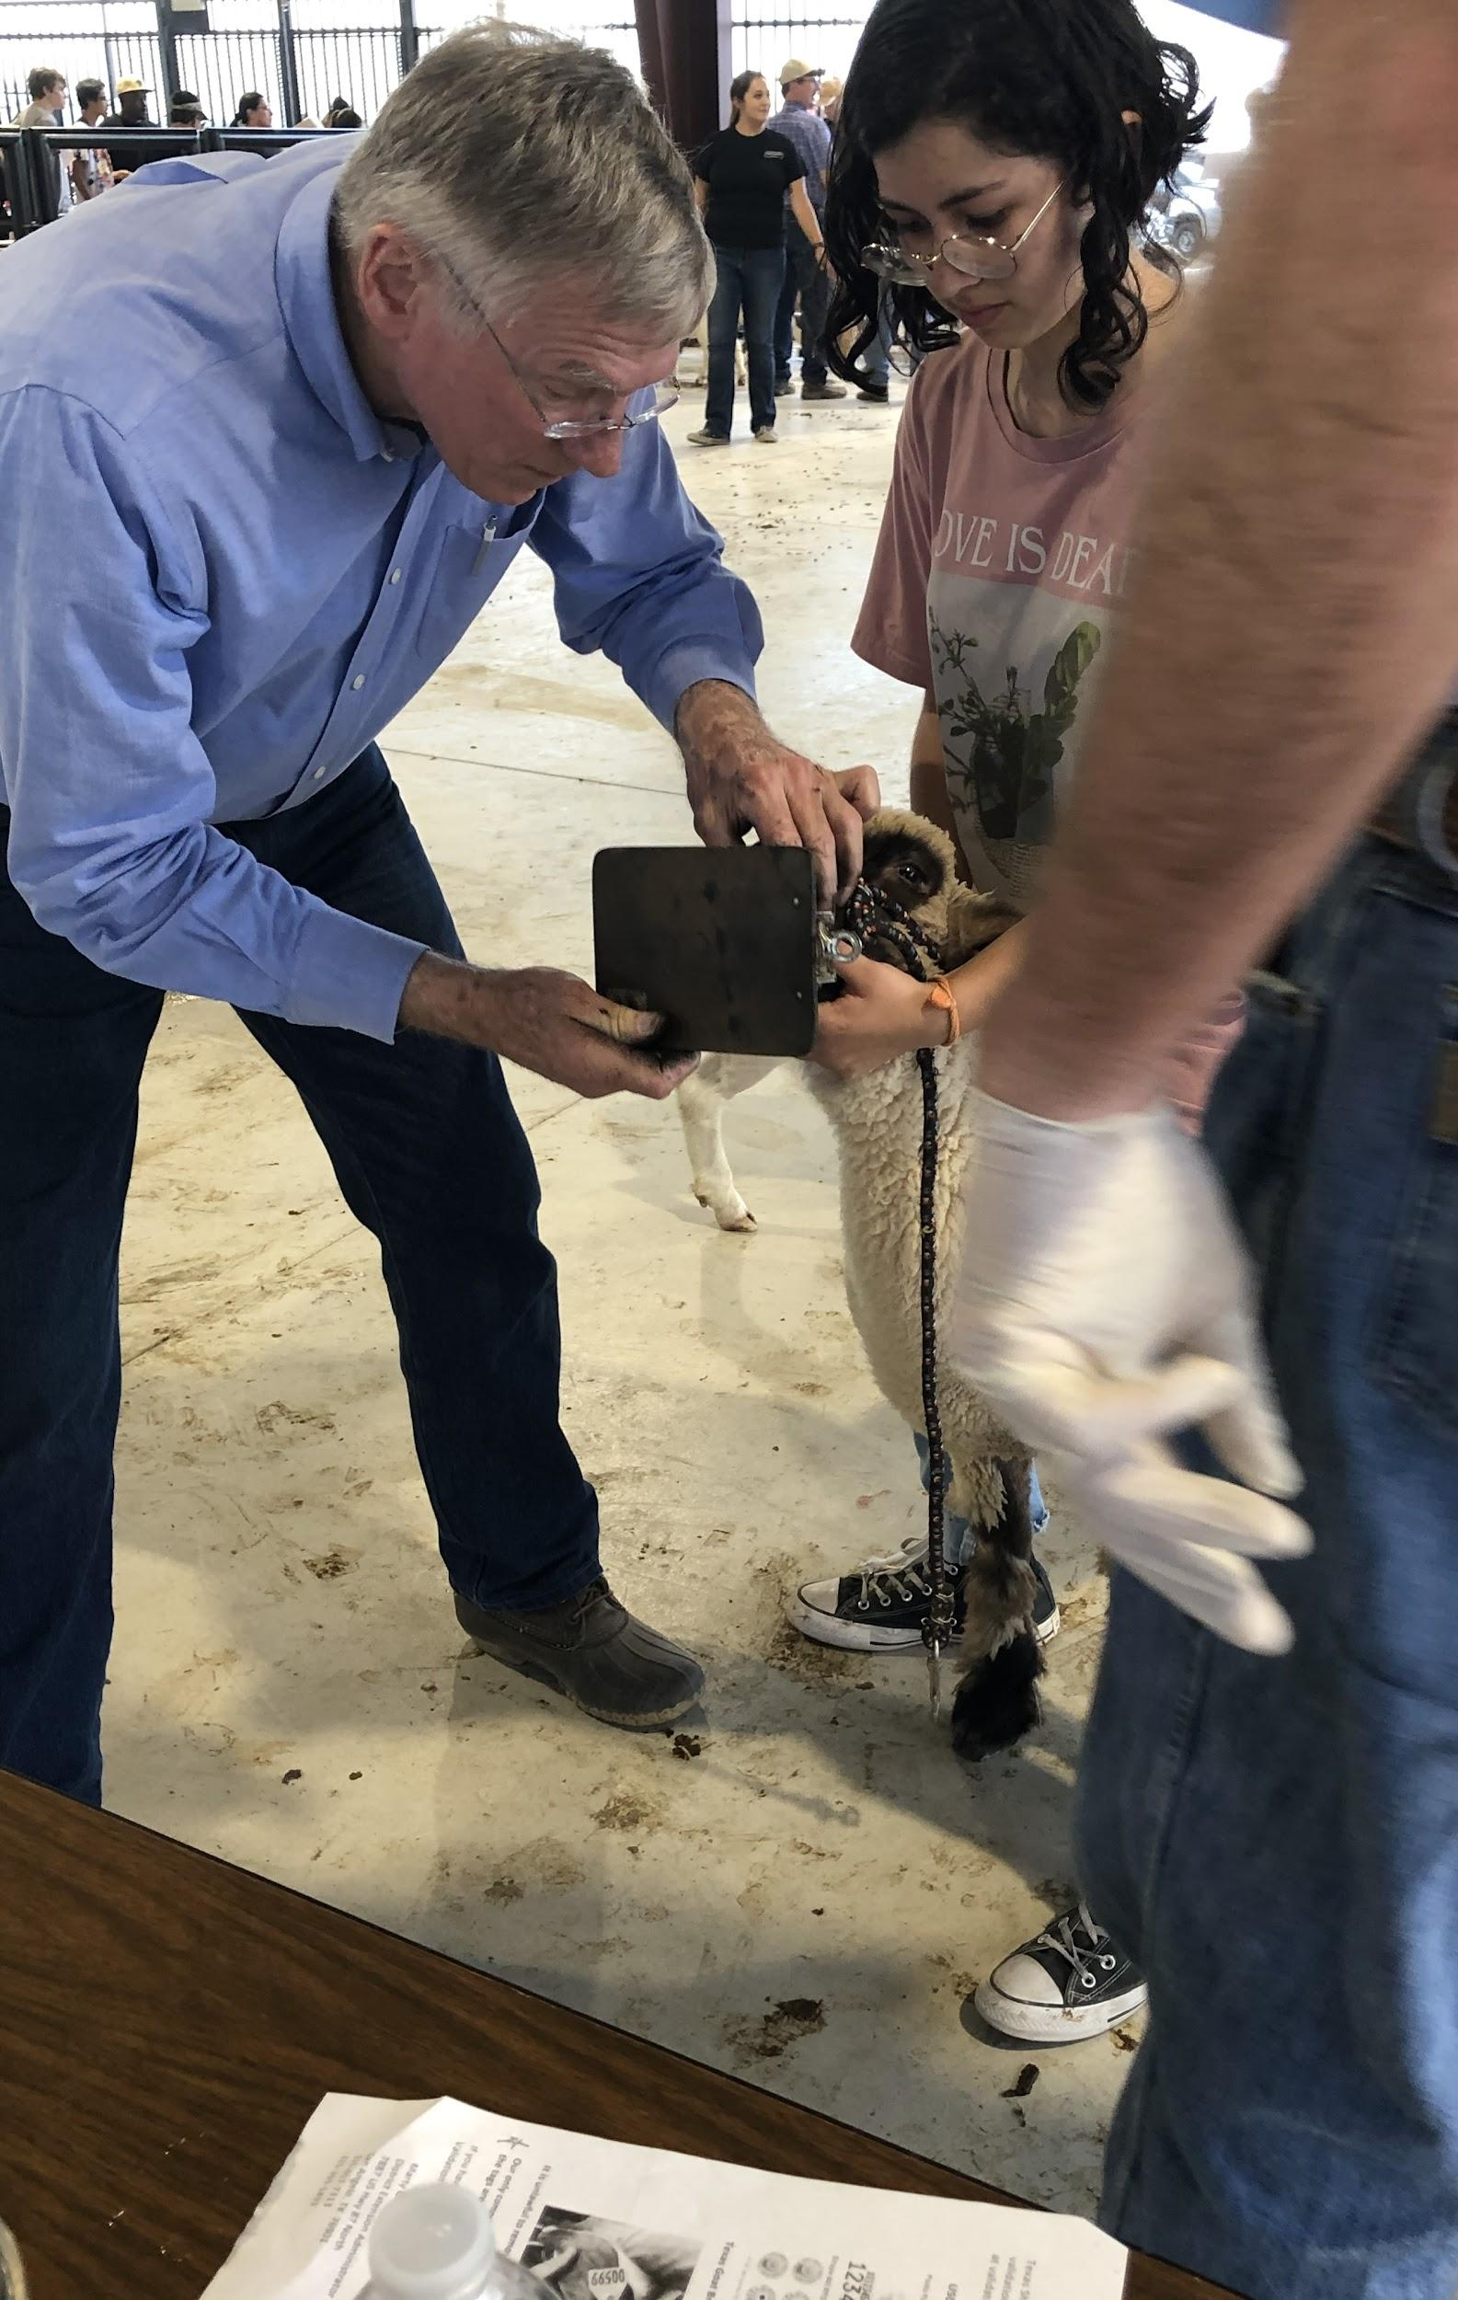
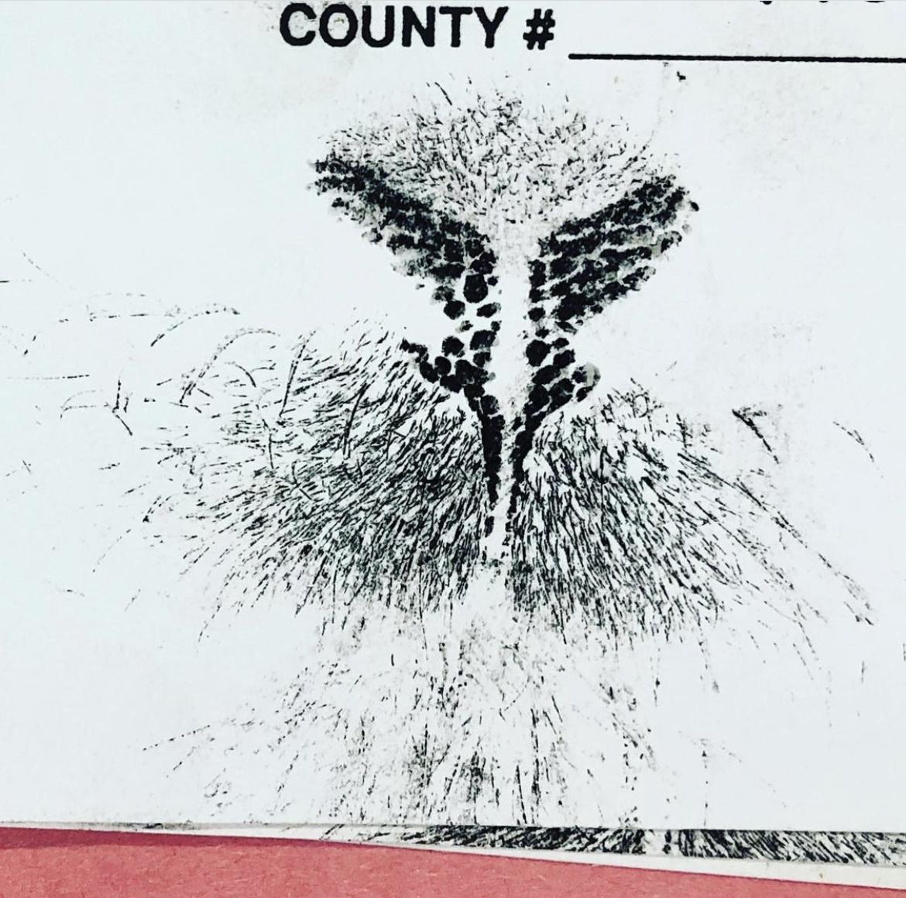
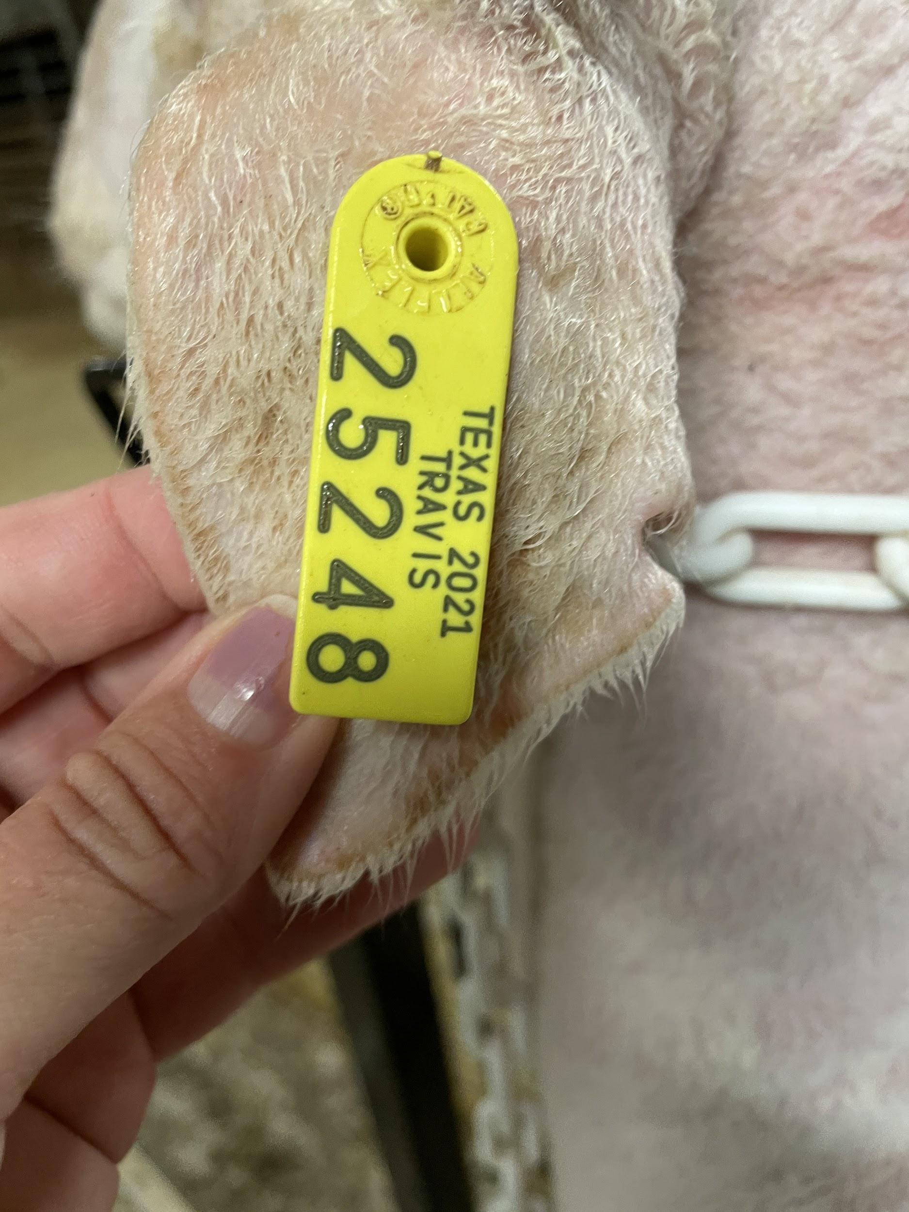
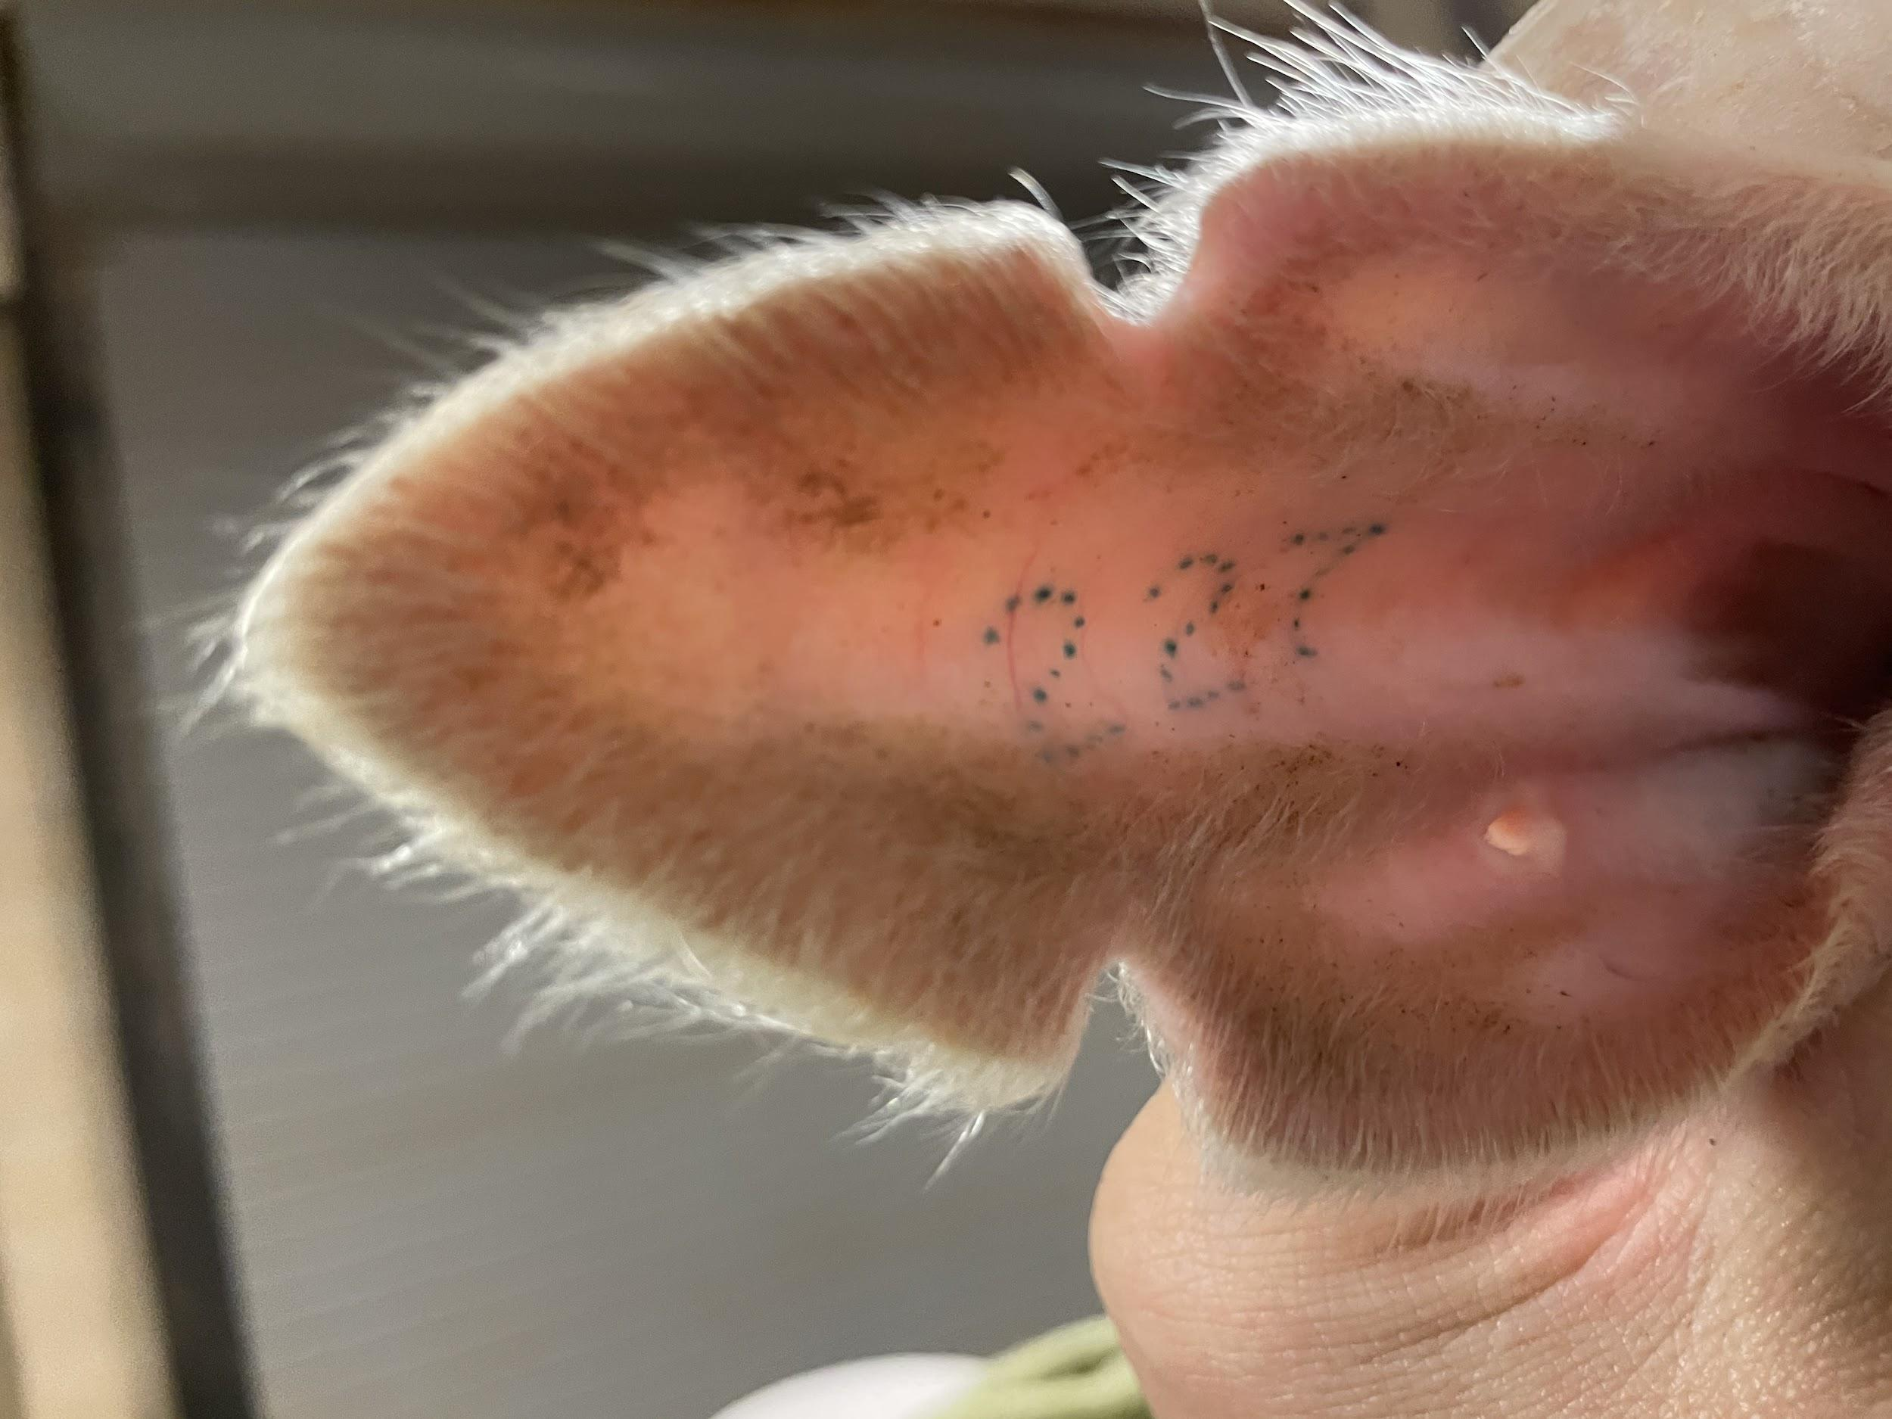
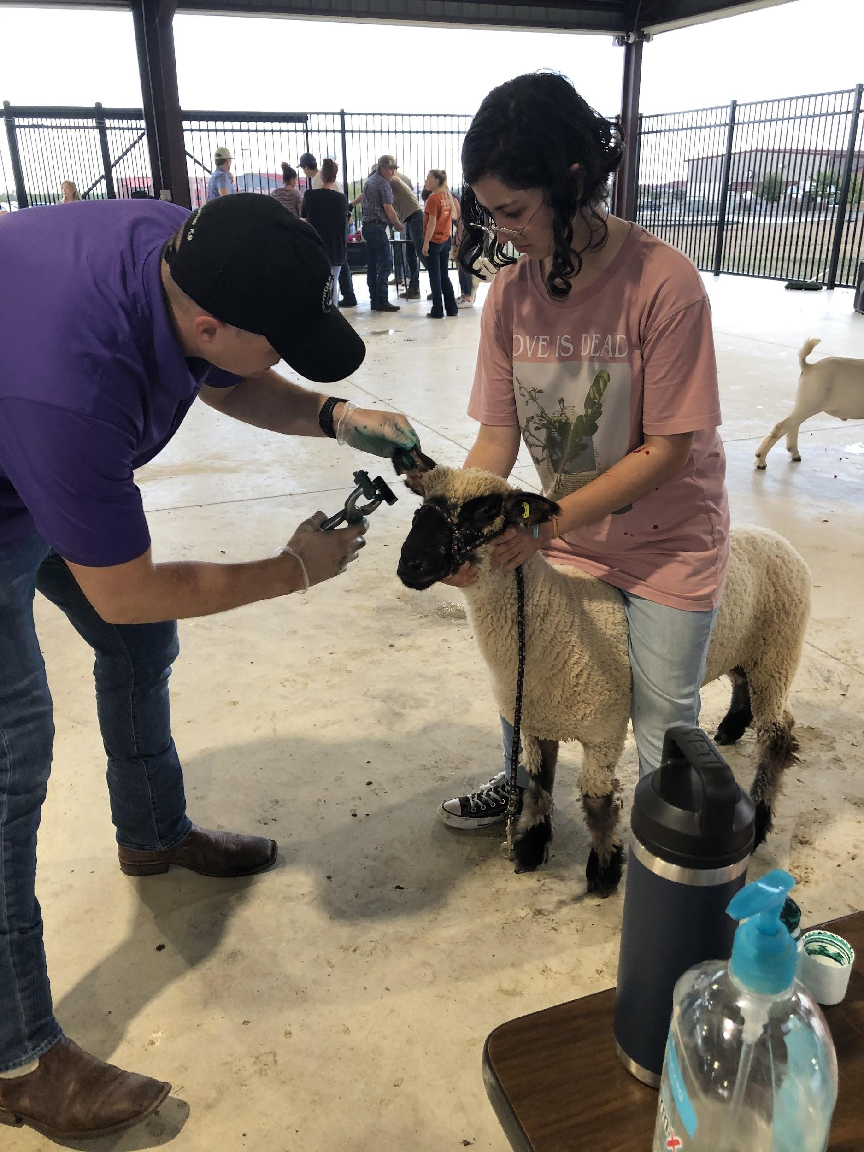
Validation: Lamb/Goat Oct 18
Pigs November 5th
P. White

Slide 21
Anything Else the Kids are Talking About:
P. White
What the Kids are Talking About:
FFA DUES
What is TCYS
TCYS
Lamb and Goat Validation Oct 18
No Pass- No Play
Eligibility Dates
Pen Rent/ Deposit
LDE’s- Lauren
FFA Jacket Order
Small Animals (Bunnies) Aline Crompton
Jackpot Shows
Quality Counts
Barn Hygiene
Homecoming parade
October Bonding Event - House of Torment
Socials
Volunteer Opportunities
Officer Position Open
Lamb & Goat Barn Expectations - AFTER MEETING for ALL lamb & goat exhibitors
Lamb & Goat Barn Expectations -
AFTER MEETING
for ALL
lamb & goat exhibitors

Slide 22
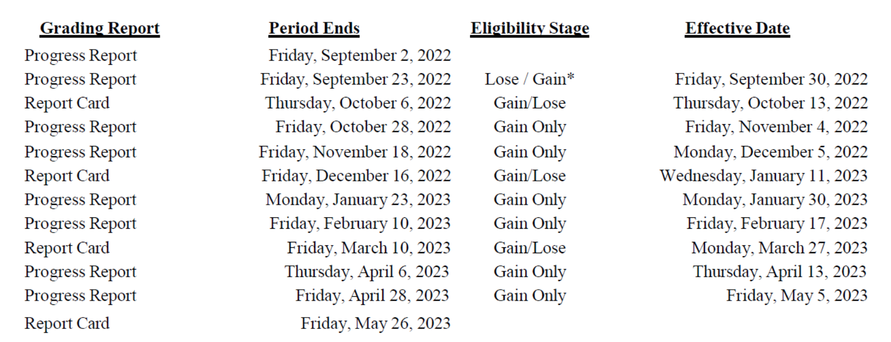
Eligibility Dates
NO PASS ~ NO PLAY
This includes Jackpot Shows, Majors, & Chapter Show
TCYS

Slide 23
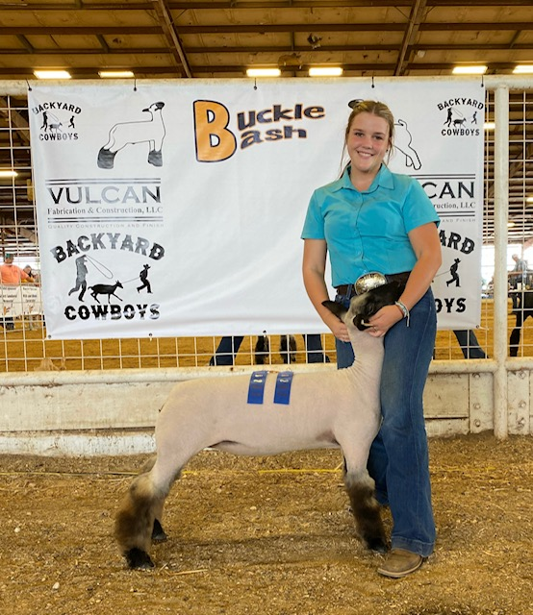
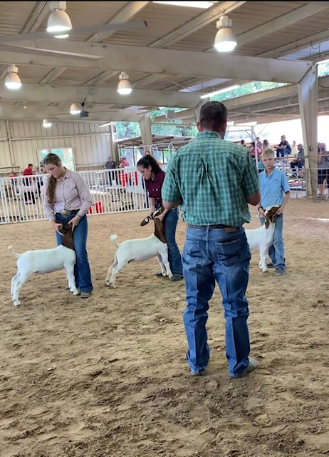
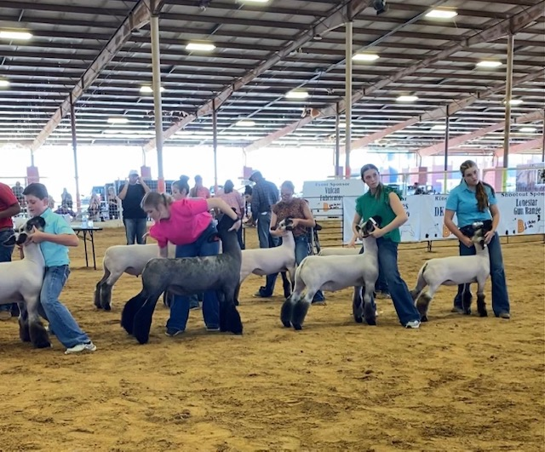
Jack Pots - Show Successes

Slide 24
New Business/Questions
Kathleen Fisher
Yard sign/car decal forms available
What is a jackpot show and do I need to go?
What is “OD” or “official dress” and does my child need it?
Where do I get info on how to raise my animal? (links on web site to species specific guides)
Other new business??
Questions??

Slide 25
Mark Your Calendar
ASAP = Order FFA jackets for LDEs
October 5 = HOCO parade 5-8 p.m.– all students can ride float – bring candy!
October 6 = House of Torment bonding event for students
October 7 = Raising Cane’s Spirit Night (HoCo Game Day)
October 12 = Sponsorship deadline for logos on shirts; TCYS project entry deadline (form available online)
October 14 = FFA alumni and student dues due for good standing
October 18 = Lamb & Goat Validation at Hendrickson’s Farm
October 24 = Pet Shot Clinic and P Terry’s Spirit Night
November 1 = Next Alumni Meeting 6 p.m.
November 4 = Major Show Entries Due
November 5 = Swine validation
November 9 = Capital District LDE competition
November 10 = Cav Classic Set-up
November 12 = Cav Classic
December 10 = LT FFA Chapter Show Here at the LT Ag Facility
January 12-15, 2022 = TCYS Travis County Expo Center

Slide 26
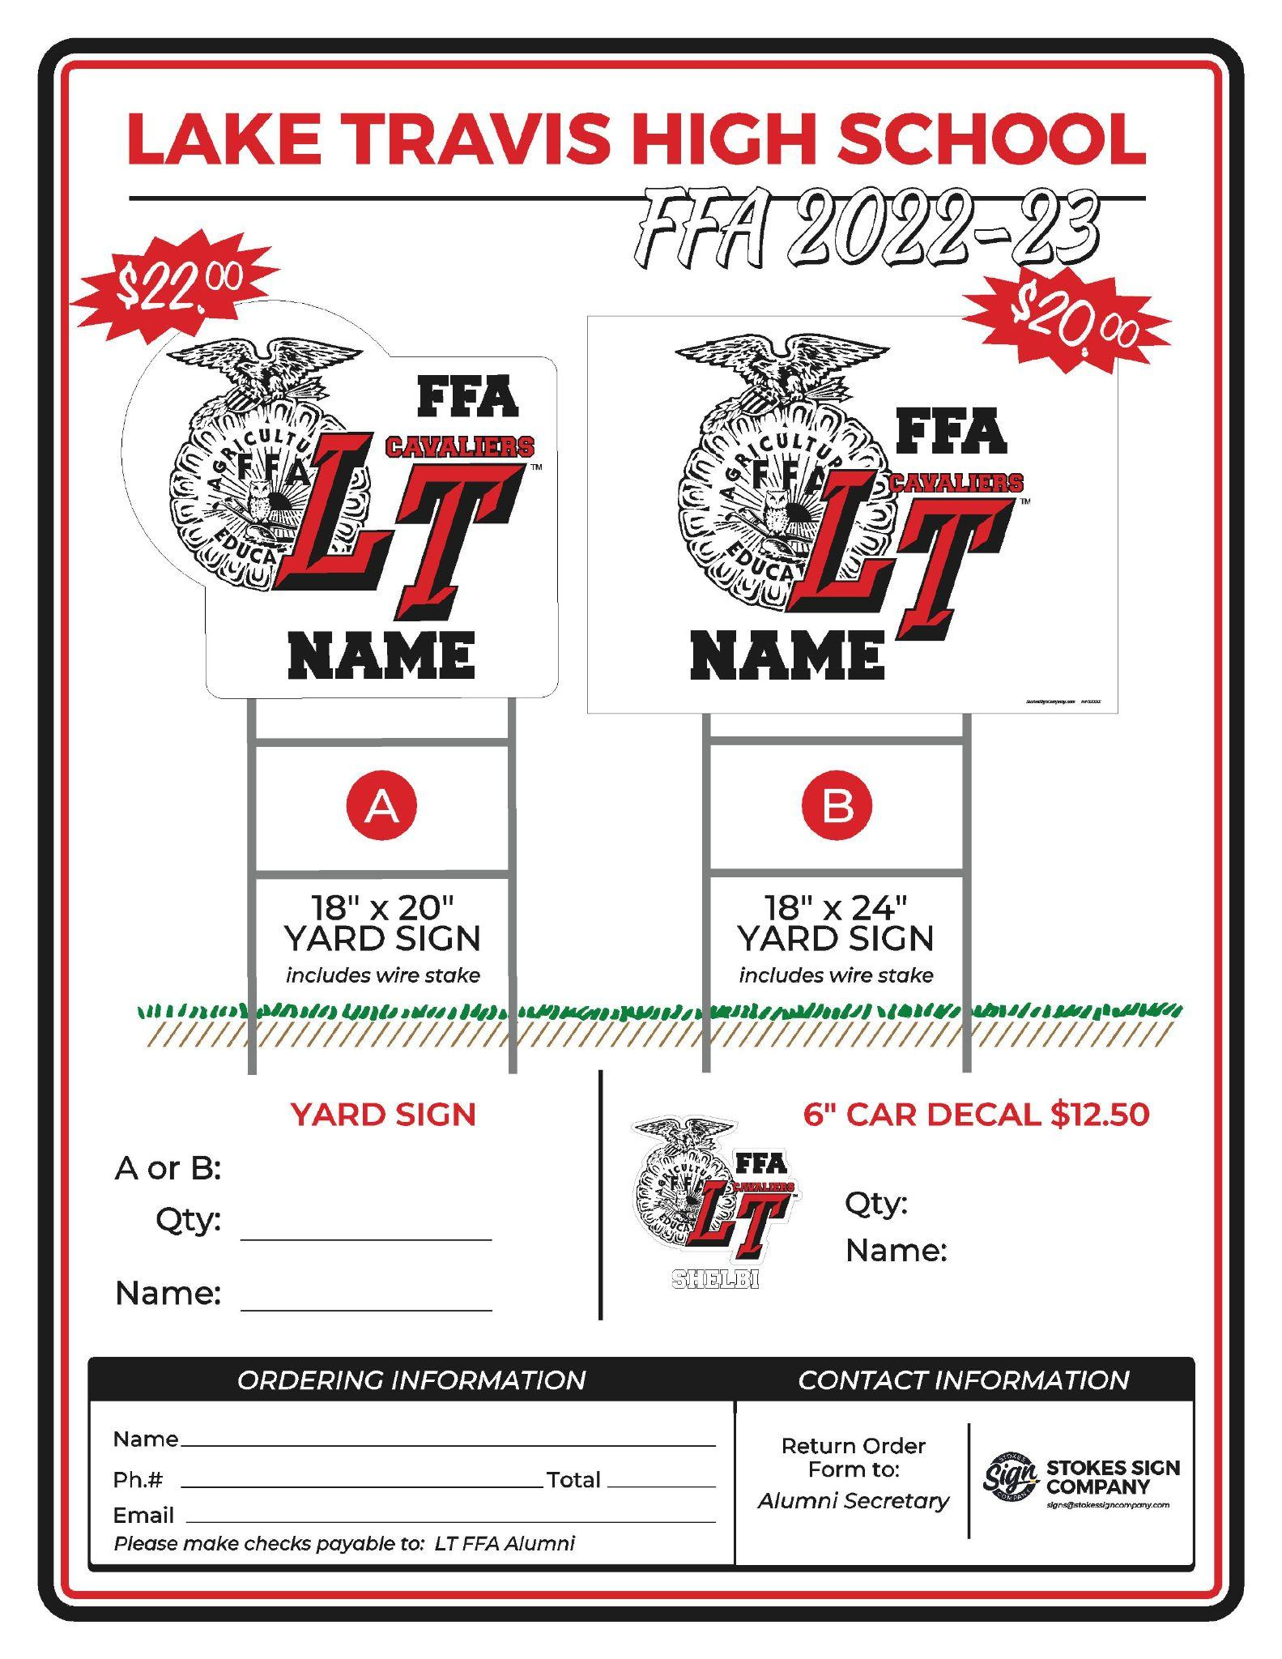
Car Decal & Yard Sign Orders
Fill out the form
Make the check out to: “LT FFA ALUMNI”
Return form to the Susan Dow, Alumni Secretary

Slide 27
Don’t forget: Join Remind Group Alerts
Kathleen Fisher
Text number: 81010
•FFA Texts - @lt-ffa
•Pigs - @oinker
•Goats - @ltgoat
•Lambs - @ltlambs

Slide 28
Friday’s Dining Experience
Raising Cane’s & Raising $
October 7th
ALL DAY !!!!

Slide 29
Next Meeting Nov 1 (6pm)
Meeting
Adjourned
Thank you for attending!

